Slide 1
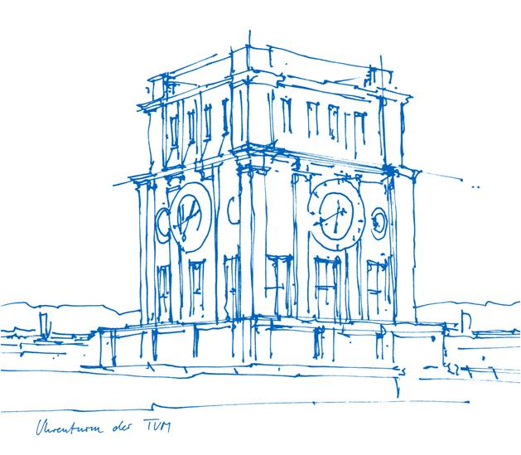
Towards Dynamic-aware SLAM with 4D Reconstruction
Youran Wang
02.04.2026

Slide 2
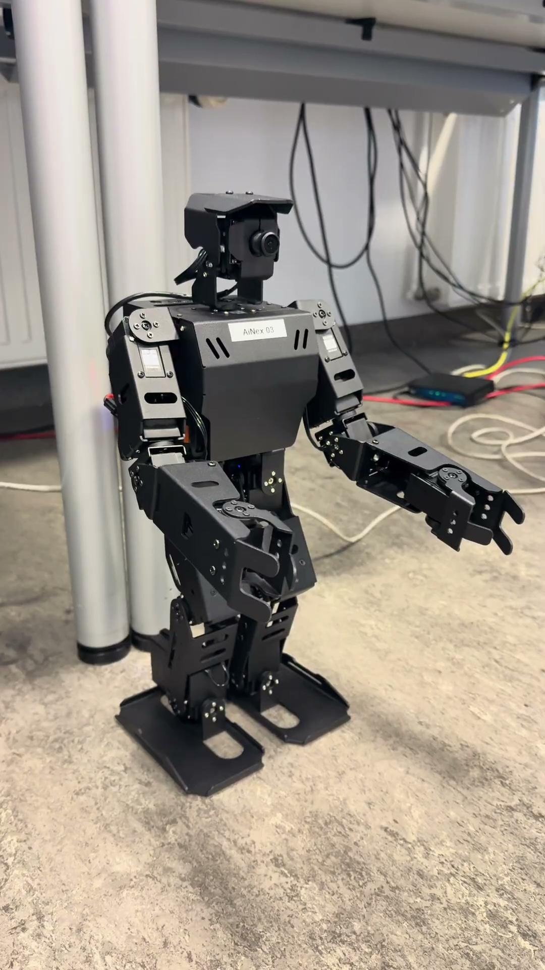
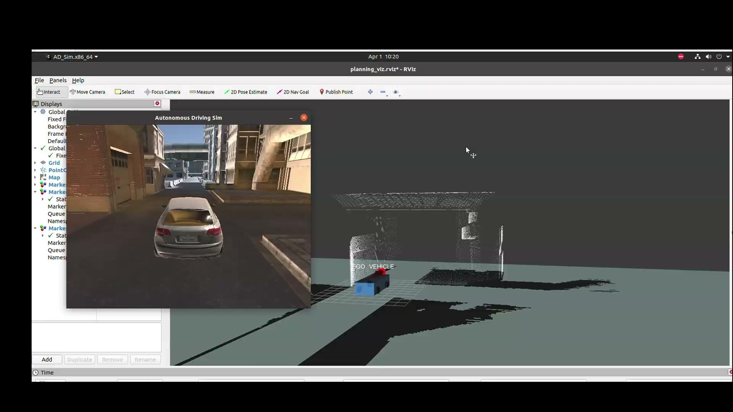
Youran Wang
github:https://github.com/Euzil
gitlab: https://gitlab.lrz.de/go73hay
Robotics, Cognition, Intelligence
Technical University of Munich, Munich
Apr. 2024 - laufend
Robotik und Autonomie System
University of Lübeck, Luebeck
Sept. 2019 - März 2024
My Projekts before:
Autonomous Driving Project
https://github.com/Euzil/Introduction_to_ROS
Sim2Real Challenge 2025
https://github.com/Euzil/SIM2REAL-2025
Cristiano Roboto
https://github.com/Euzil/Christiano_Roboto

Slide 3
Review: FoundationSLAM: Unleashing the Power of Depth Foundation Models for End-to-End Dense Visual SLAM
matching without Geometry
no multi-view consistency
RGB
Hybrid Flow Network
Bi-Consistent Bundle Adjustment
Reliability-aware Refinement
Geometry Prior Branch
Task-specific Branch
u_i at frame i
small error → reliable
large error → unreliable
u_i + depth → 3D
3D → frame j → u_proj
compare u_proj with flow

Slide 4
Review: V-DPM: 4D Video Reconstruction with Dynamic Point Maps
DUSt3R / VGGT
Only static scenes can be processed
MonST3R
It can perform 4D operations
relies on 2D tracking (optical flow/keypoints) and is not a "pure 3D representation
Dynamic Point Maps（DPM）
A unified representation of 3D + motion
only handle two images (pairwise); multi-frame processing requires optimization (slow and complex)
Time-variant Head (DPT)
Scene Flow Tracking
ΔP = P_i(t_j) - P_i(t_i)
P0(t0) → P0(t1) → ... → P0(tN)
P_i(t_i, π0)
1.patch tokens
2.camera token
3.register tokens
Feature tokens: p̂_i
VGGT Backbone
Frame attention（帧内建模）
Global attention（跨帧建模）
Video frames
Time-conditioned Decoder (Transformer)
Aligned feature (t_j)
Time-invariant Head (DPT)
p̂_i
P_i(t_j, π0)
Camera tokens: ĉ_i
Camera Head

Slide 5
FoundationSLAM
conclusion
More accurate (lower ATE)
Reconstruction is better (lower Chamfer distance).
Real-time (18 FPS)
Innovation
Deep fusion of Flow and Geometry;
Bi-consistent BA;
Residual-driven structured correction;
True closed-loop optimization (end-to-end).
V-DPM
conclusion
Compared to previous methods:
error rate ↓ ~5 times
In multi-frame scenarios: DPM performance degrades
V-DPM remains stable
Qualitative
Smoother, More consistent, No more breakage
Innovation
Two-stage decomposition;
Time-conditioned transformer;
Transfer learning using static models.

Slide 6
Q&A

